Slide 1

Lead Scoring Case Study
Shivansh Singh
Sahil Rajiv Chand
May 2024 SA (CS68)

Slide 2
Agenda
Lead Scoring Case Study
1.
Problem Statement
2.
Data Understanding & Preprocessing
3.
EDA Analysis
4.
Model Development & Results
5.
Key Findings & Recommendations

Slide 3
Problem Statement
Lead Scoring Case Study
Current Scenario:
• X Education generates a lot of leads through digital marketing
• Only 30% of leads are converting to paid customers
• Sales team spends equal time on all leads
Business Challenge:
• Need to identify "Hot Leads" with higher conversion probability
• Target to increase conversion rate to 80%
• Optimize sales team's time and efforts
Solution Required:
• Build a lead scoring model (0-100)
- Higher score = Hot lead (more likely to convert)
- Lower score = Cold lead (less likely to convert)

Slide 4
Agenda
Lead Scoring Case Study
1.
Problem Statement
2.
Data Understanding & Preprocessing
3.
EDA Analysis
4.
Model Development & Results
5.
Key Findings & Recommendations

Slide 5
Data Understanding
Data understanding & Preprocessing
Analysis Approach
Lead Scoring Case Study
Dataset Overview:
• ~9,000 lead records with 37 features
• Key Variables:
- Lead Source (Google, Direct Traffic, etc.)
- Website Behavior (Total Visits, Time Spent)
- Lead Demographics
Data Quality:
• Missing Values
• 'Select' Categories
• Duplicate Entries: None

Slide 6
Data Preprocessing Steps
Analysis Approach
Lead Scoring Case Study
3 Phase Preprocessing Strategy
1
2
3
Data Cleaning
Feature Engineering
Feature Selection
Handled missing values
Removed redundant columns
Treated ‘Selected’ categories as null
Categorical variable encoding
Outlier treatment for: Total Visits, Time on website, Page views per visit.
Used RFE
Selected 13 most important features

Slide 7
Agenda
Lead Scoring Case Study
1.
Problem Statement
2.
Data Understanding & Preprocessing
3.
EDA Analysis
4.
Model Development & Results
5.
Key Findings & Recommendations

Slide 8
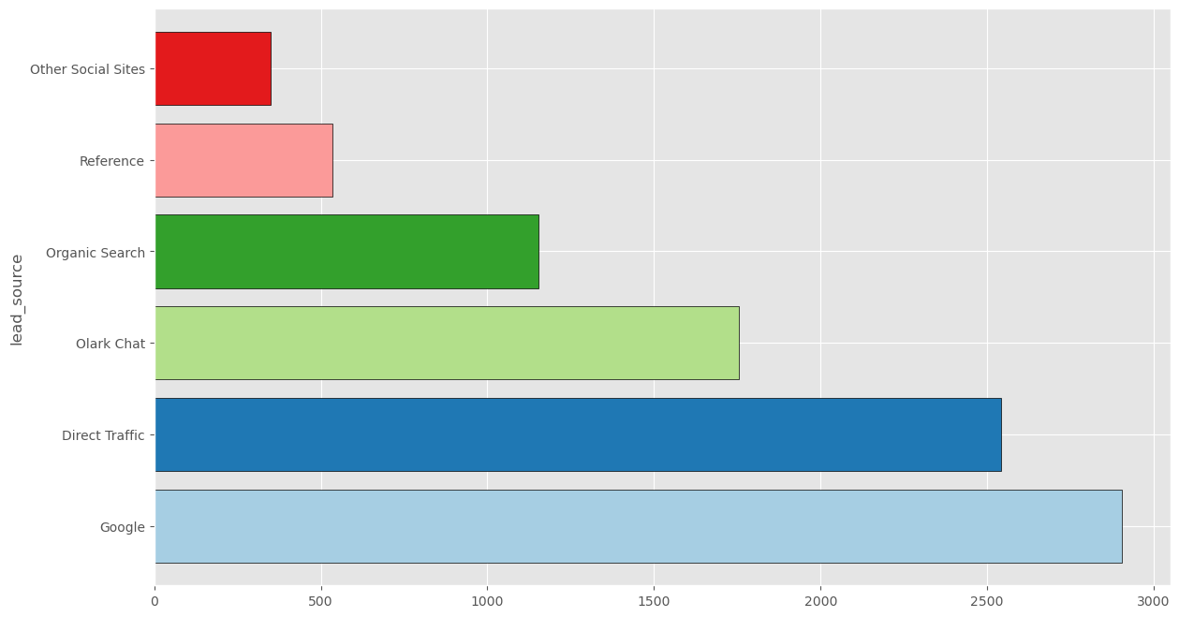
Forming a Hypothesis
Lead Scoring Case Study
Lead Source Analysis
Google (31%) - Primary Source
Direct Traffic (28%)
Olark Chat (19%)
Organic Search (12%)
Others (10%)
Key Insights
Digital channels contribute to 80% of lead generation

Slide 9
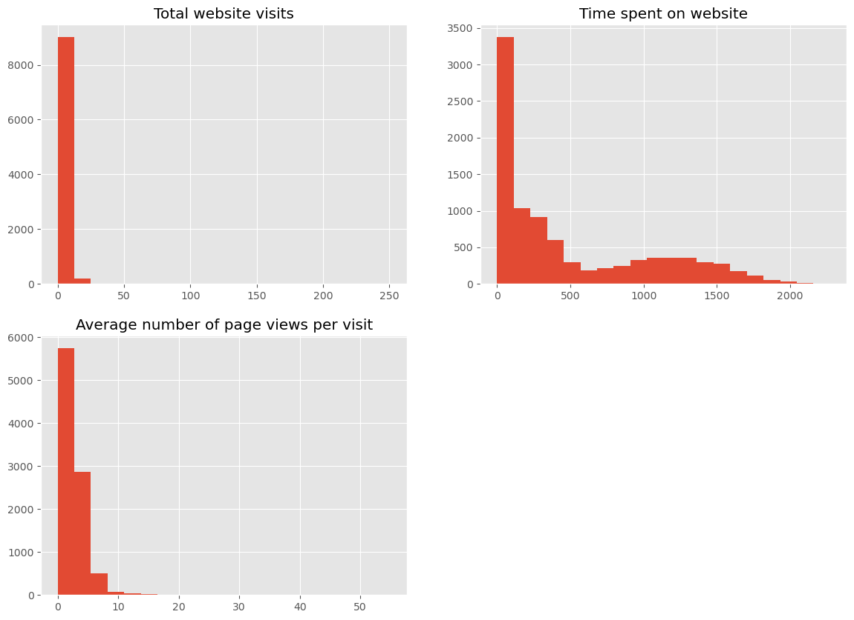
Forming a Hypothesis
Lead Scoring Case Study
User Engagement Metrics:
• Total Visits
• Time Spent on Website
• Page Views per Visit
Key Findings:
• Average visits per lead: 3.4
• Significant correlation between page views and conversion
• Time spent on website strongly indicates interest

Slide 10
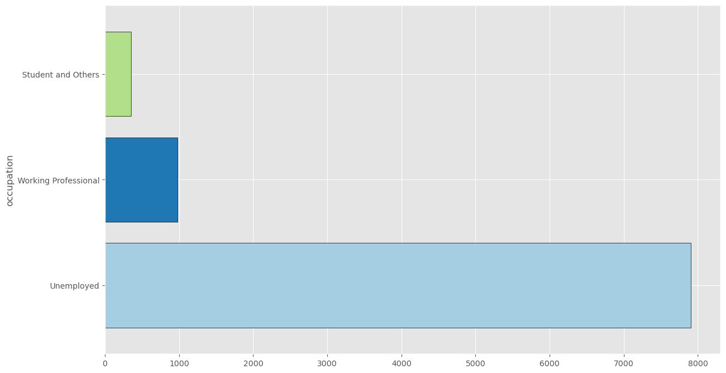
Forming a Hypothesis
Lead Scoring Case Study
Demographic Analysis
Geographic Distribution:
• Mumbai: 58%
• Non-Mumbai Maharashtra: 22%
• Other Cities: 20%
Occupation Profile:
• Unemployed: 86%
• Working Professional: 11%
• Others: 3%
Key Insight:
Location and occupation significantly impact conversion probability

Slide 11

Forming a Hypothesis
Lead Scoring Case Study
Feature Correlations
Key Correlations:
• Time on Website ↔ Conversion
• Total Visits ↔ Page Views
• Lead Origin ↔ Conversion Rate
Impact Factors:
• Website engagement metrics show strongest correlation
• Lead source quality varies significantly

Slide 12
Agenda
Lead Scoring Case Study
1.
Problem Statement
2.
Data Understanding & Preprocessing
3.
EDA Analysis
4.
Model Development & Results
5.
Key Findings & Recommendations

Slide 13

Model Development
Analysis Approach
Lead Scoring Case Study
Approach:
• Algorithm: Logistic Regression
• Train-Test Split: 70-30
• Feature Selection: RFE (Recursive Feature Elimination)
• Standardization: Applied to numerical features
Selected Features:
Total Visits, Time on Website, Page Views per Visit, Lead Origin, Lead Source, Specialization, Occupation, City

Slide 14
Model Results & Performance
Lead Score Case Study
Key Model Metrics:
Current Conversion Rate: 38.5% & Target Conversion Rate: 80%
Most Significant Predictors:
1. Website Engagement:
• Time spent on website
• Total visits
• Page views per visit
2. Lead Characteristics:
• Lead origin: Landing Page
• Lead source: Google/Direct Traffic
• Location: Mumbai region

Slide 15
Agenda
Lead Scoring Case Study
1.
Problem Statement
2.
Data Understanding & Preprocessing
3.
EDA Analysis
4.
Model Development & Results
5.
Key Findings & Recommendations

Slide 16
Key Findings Summary
Lead Scoring Case Study
Key Findings Summary
Prioritize leads
with
Higher website engagement
Multiple visits
More time spent on website
1.
Focus on High-Converting Channels
Google
Direct Traffic
Landing Page Submissions
2.
3.
Geographic Focus
Mumbai and Maharashtra region
Targeted campaigns for other cities
4.
Process Implementation
Daily lead scoring
Regular model retraining
Performance Monitorig

Slide 17
THANK YOU!

